Slide 1
VETERANS
Scaling Hourly Constants

Slide 2
Initial Calibrated Constants
I – 95 Express Lanes Observed Data
Hourly Constants are result of calibration to the observed EL Shares
Transferability of Constants
Generally not transferable to any projects as VOT varies.
But if the Time and Toll Coefficients are retained (assuming the new project location has the same VOT as the I-95), then the constants are portable.
When the VOT is different the constants render no meaning as they go out of calibration.
Few attempts to use the calibrated constants without loss of calibration.

Slide 3
Constants as Equivalent Minutes
Constants are often analyzed in Eq. Minutes.
Converted by dividing it with IVTT coefficient
I-95 Express Lanes Calibrated Constants are expressed as Eq.Mins
I-95 and Veterans Parameters
VETS Constants
I-95 Constants
Same IVTT and so scaling results in the same constant

Slide 4
1. Eqv. Mins Results : 2020 New Policy

Slide 5
Constants as Equivalent Dollars
Constants can also be measured as Cost equivalents (not commonly used)
Converted by dividing it with Cost coefficient
I-95 Express Lanes Calibrated Constants are expressed as Eq. $
VETS Mainline are already paying a Toll and thus discounting 25 Cents
I-95 and Veterans Parameters
VETS Constants
I-95 Constants

Slide 6
2. Eq. $ Results : 2020 New Policy

Slide 7
Constants scaled by ratio of VOT
Constants can be scaled by VOT
Basically taking both Time and Cost into account
I-95 Constants
I-95 and Veterans Parameters
VETS Constants

Slide 8
3A. VOT Ratio Results : 2020 New Policy

Slide 9
Constants scaled by ratio of VOT (inverse)
Constants can be scaled by VOT
Basically taking both Time and Cost into account
I-95 Constants
I-95 and Veterans Parameters
VETS Constants

Slide 10
3B. VOT Ratio Results (Inverse): 2020 New Policy

Slide 11
4. Constants scaled to preserve relation across periods
Consistent scaling to preserve the absolute difference between ON and rest of the periods close to the differences observed in the I-95 constants.
This is independent of Time, Cost and VOT.
The ON share is computed to match an expected share of 10% which is close to I-95 express.
VETS Constants
I-95 Constants
I-95 and Veterans Parameters

Slide 12
4. Consistent Relational Across Periods: 2020 New Policy

Slide 13
Conclusions
Although all of them produce same results, there are subtle differences:
Equiv. Dollars is least preferred as the initial toll paid on the Mainline is not consistent (one trip may experience 25 cents and other could be 50 cents) and its hard to defend a varying cost disutility.
Relational Consistency Across Periods: The relationship can be established for interpretation sake (ex: we understand in peak it’s 5 mins equivalent and so it could be 10 mins during offpeak) but scaling to preserve relationship can entirely move the constant out of calibration and could end up with undesirable magnitude as it may take a large constant to estimate 10% ON share.
VOT Ratio makes a better choice as it takes into both cost and time coefficients ratio. Simple to explain, much easy to transfer the constants.
Equiv. Mins is the preferred method as there are no further biases introduced in the model and the constant is simply interpreted as having the same equivalent minutes irrespective of any other utility changes.

Slide 14
Revisions
Eligible Trips
Observed Peak hour factors
Check with Traffic on what peak hour volume is used in micro simulation (by direction and by hour)
OD Trip tables scaled to match observed (~10%)

Slide 15
Eligible Trips
Eligible Trips
Network Attributes

Slide 16
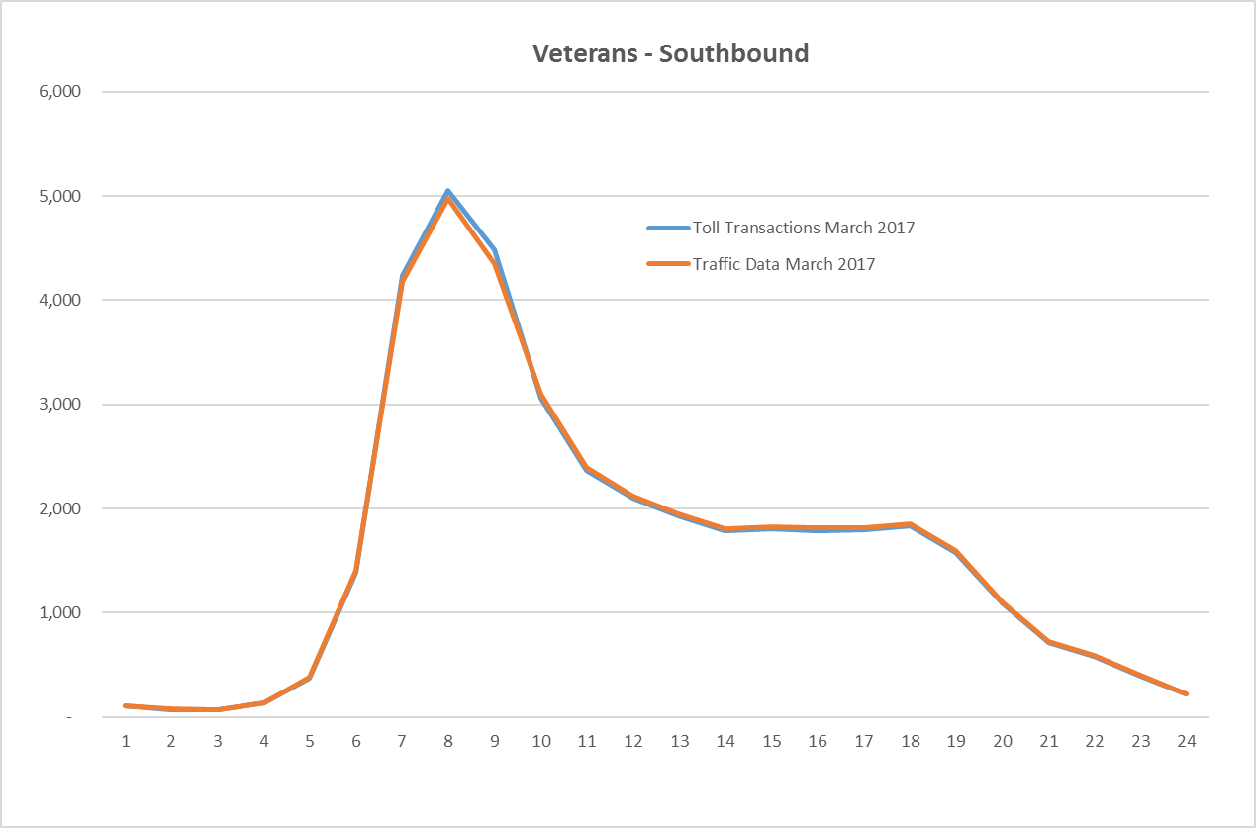
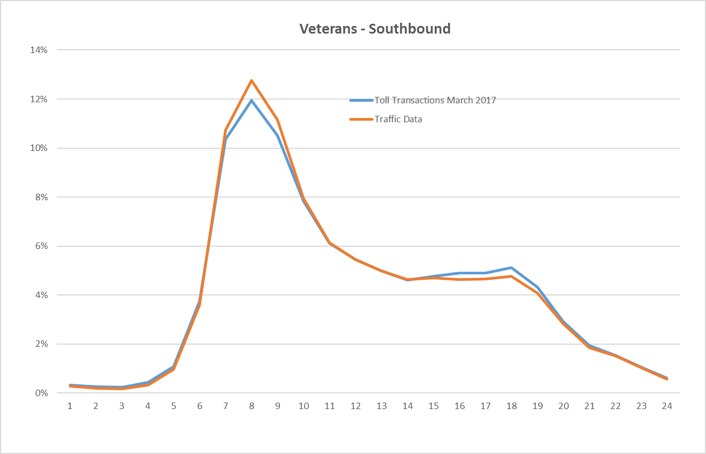
Hourly Distributions
1. Model used an average distribution between Sugarwood Plaza and Anderson Plaza which is slightly lower than distribution provided by Traffic.
2. The model originally developed for Finance used a lower (suppressed peak hour distribution to produce a conservative toll estimates by hour)
Volumes
Shares

Slide 17
1.Eqv. Mins Results : 2020 New Policy
2017 Peak Hourly Distribution : Revised to match to Anderson Plaza Traffic Distribution

Slide 18
1.Eqv. Mins Results : 2020 New Policy
10 percent increase in OD trip table: 2020 TEAR is lower than 2017 observed data (TEAR is AADT, not AAWDT)

Slide 19
1.Eqv. Mins Results : 2020 New Policy
2017 Peak Hourly Distribution + 10 percent increase in OD trip table: 2020 TEAR is lower than 2017 observed data (TEAR is AADT, not AAWDT)

Slide 20
Hourly OD Trip Tables: Hourly Factoring vs ODME

Slide 21
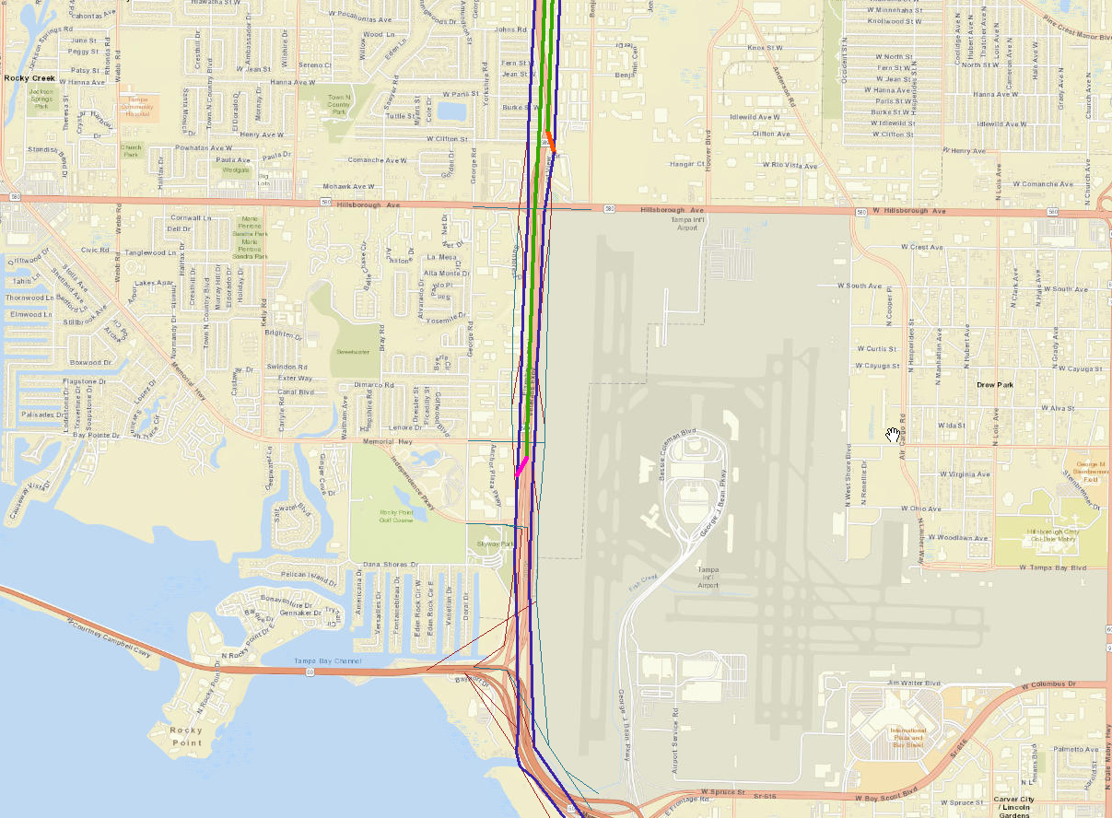
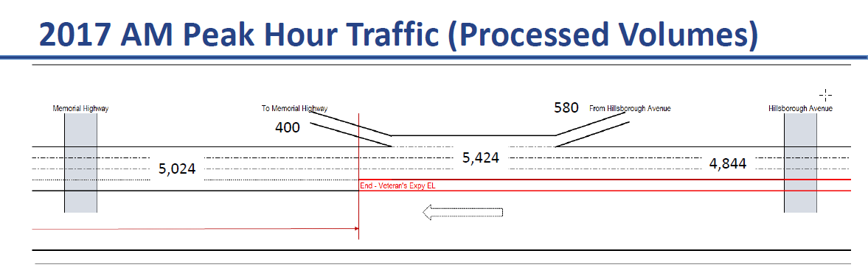
Processed Volume vs Modeled (8:00 AM)
One hour Model Assigned volume is about ~7000 on SB between Hillsborough and Memorial (5900 GL + 850 EL)
Issue:
Processed volumes show ~ 5,400 trips between Hillsborough Avenue and Memorial Hwy where the modeled assignment for one hour (8:00 AM) shows ~7,000 trips

Slide 22
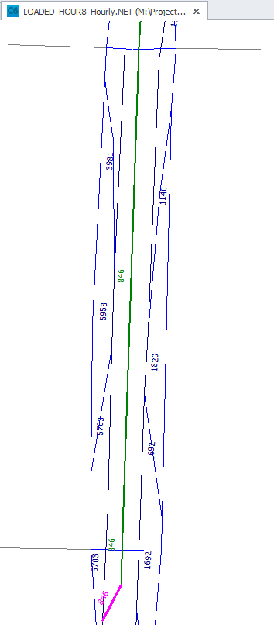
Processed Volume vs Modeled (8:00 AM)
Why are loaded volumes different:
Profile shows 83,600 (NB + SB) and 13% is 8:00 AM shares. This computes to 41,000 Daily SB and 5,434 8:00 AM hourly volumes.
However, the trip tables are ODME’d at daily to match 41,000 (SB) and the trip table is apportioned to hourly factor, which when assigned estimates ~7,000 trips instead of ~5,400.
ODME should be performed at each of the 24 hours
One hour Model Assigned volume is about ~7000 on SB between Hillsborough and Memorial (5900 GL + 850 EL)

Slide 23
1.Eqv. Mins Results : 2020 New Policy
2017 Peak Hourly Distribution : Revised to match to Anderson Plaza Traffic Distribution
Problem:
1. While Aderson Plaza SB volumes match the processed volumes of 4,400 for 8:00 AM, the downstream and upstream links show a heavier volumes.
2. This is a result of splitting Daily trip table to hourly trip tables and assigning the one hour demand. The distribution at this hour still follows a daily pattern and thus represents a traffic that is different from the field.

Slide 24
Processed Volume vs Modeled
Solution:
ODME each hour with control total developed from same profile and hourly distribution.
This should address the inconsistency in the matrix apportion vs actual period distribution.

Slide 25
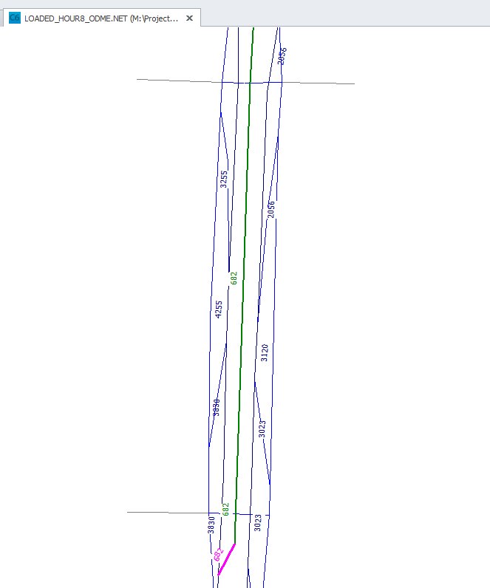
Hourly ODME Trip Table: 8:00 AM
One hour Model Assigned volume is about ~4900 on SB (4200 GL + 680 EL)

Slide 26
Assigning ODME Trip Tables (8:00 AM OD)
Solution:
ODME each hour with control total developed from same profile and hourly distribution.
This gets the .
NOTE:
Only 8:00 AM is ODME’d Trip Table
Need to repeat this for all 24 hour trip tables (time consuming, at least do it for peak hours)

Slide 27
Assigning ODME Trip Tables (all hours)
ODME each hour:
Assigning ODME trip tables to the network produce more reasonable EL trips (in range of ~500 to ~600) for SB
NB is too high:
The ODME control totals by hour should be revisited. These seem too high. The corridor volumes are estimated at

